Slide 1

WELCOME TO DEMC SPECIALIST HOSPITAL SHAH ALAM
YOUR BOUTIQUE HEALTHCARE

Slide 2
DEMC ACCREDITATION PROCESS:
1ST CYCLE ACCREDITATION ON 3RD EDITION STANDARDS 2012

Slide 3
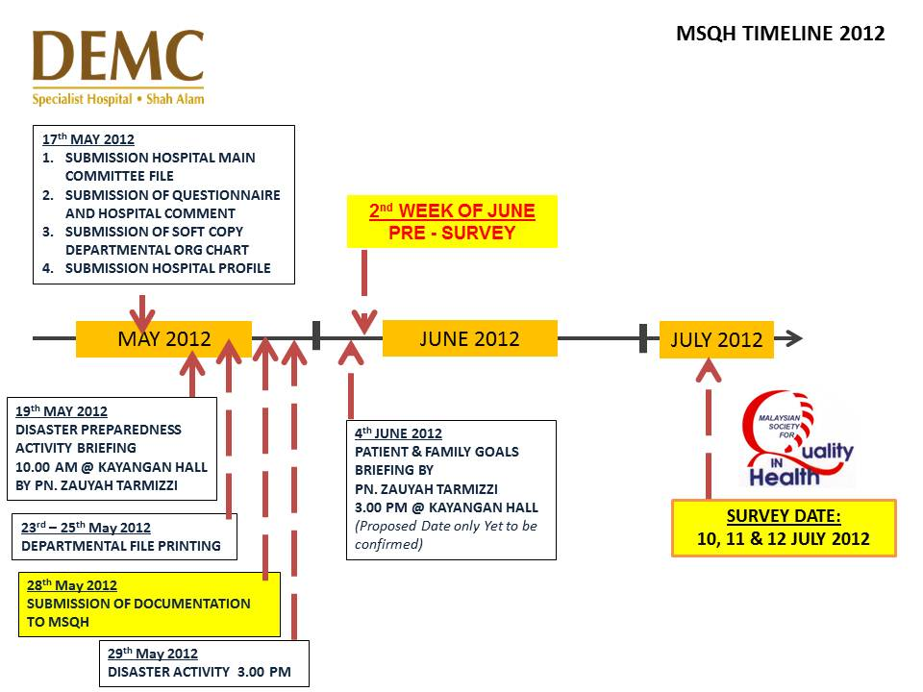
MSQH JOURNEY IN DEMC:

Slide 4
Validity of MSQH’s 1st Accreditation in DEMC :
12th July 2012 till 12th July 2015
( 3rd Edition )

Slide 5
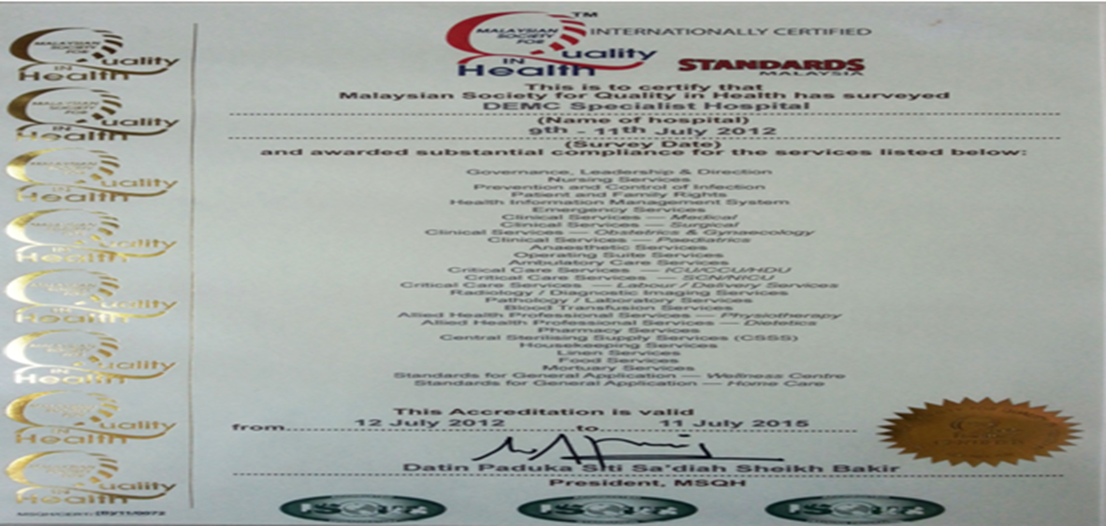

Slide 6
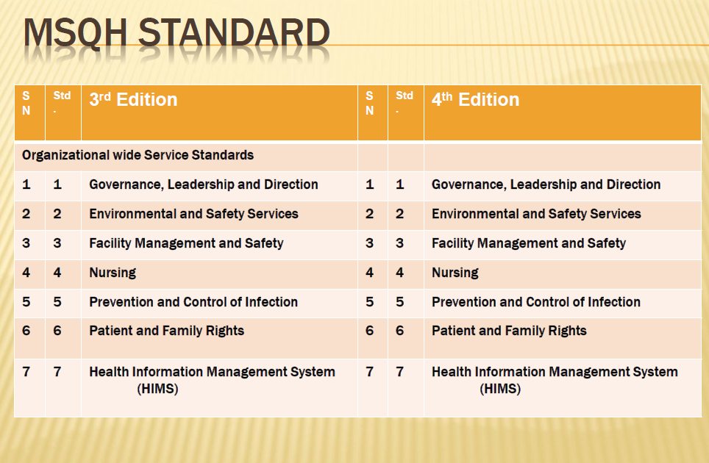
MSQH 3rd & 4th EDITION STANDARD:

Slide 7
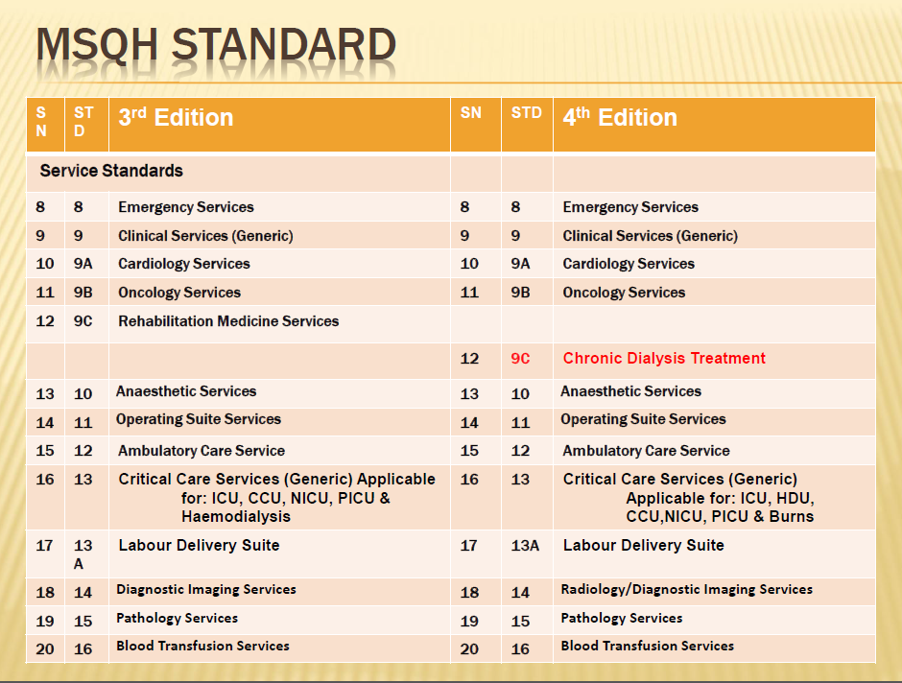

Slide 8
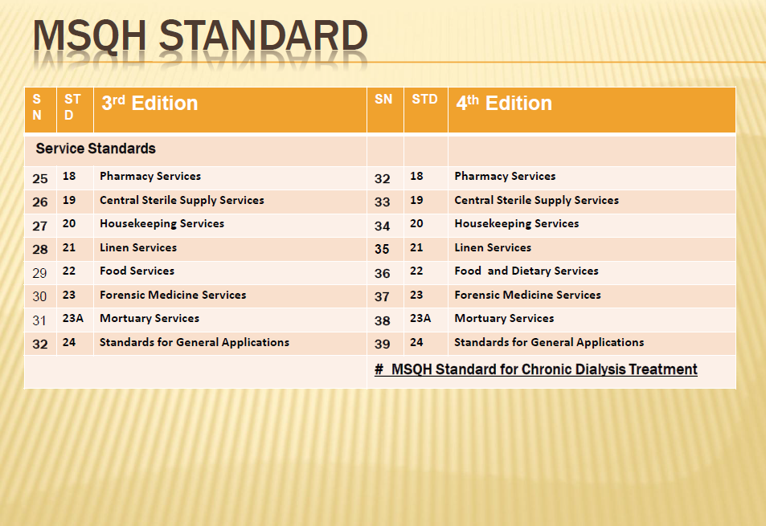

Slide 9
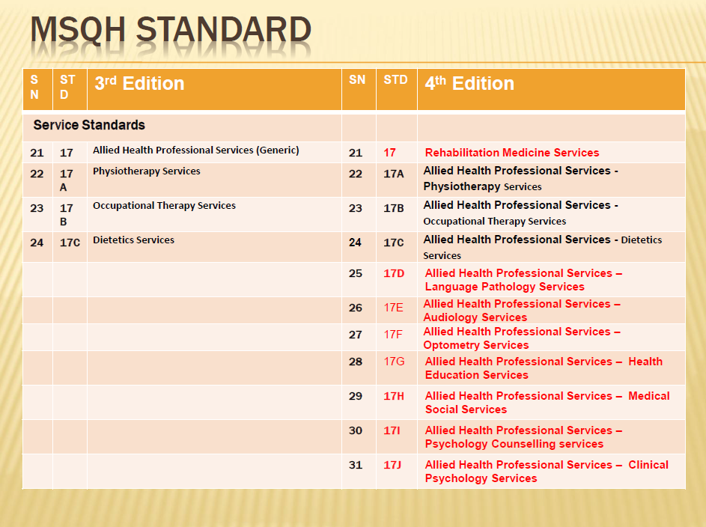

Slide 11
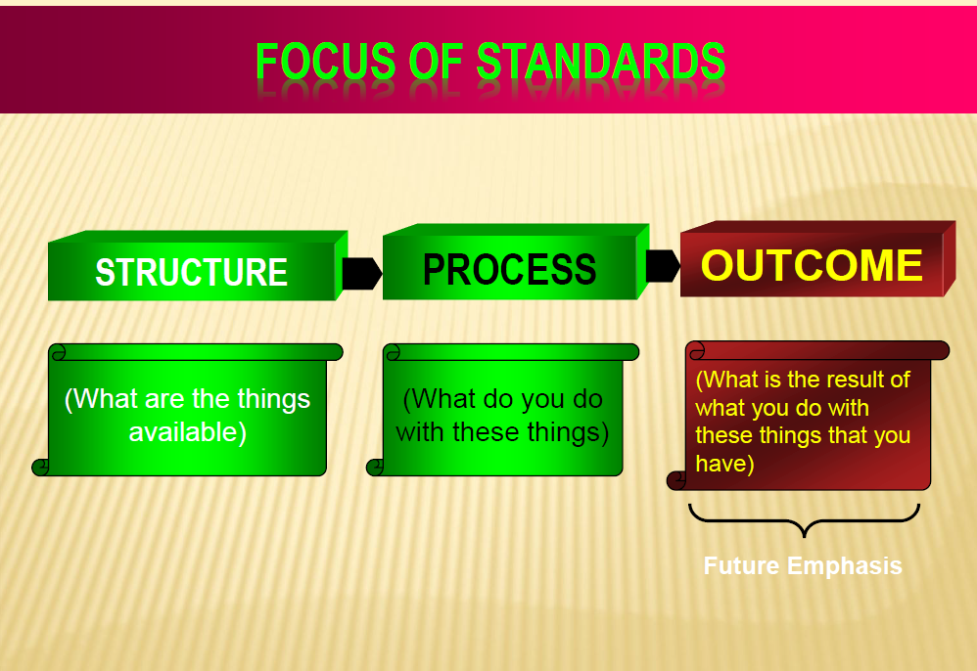

Slide 12
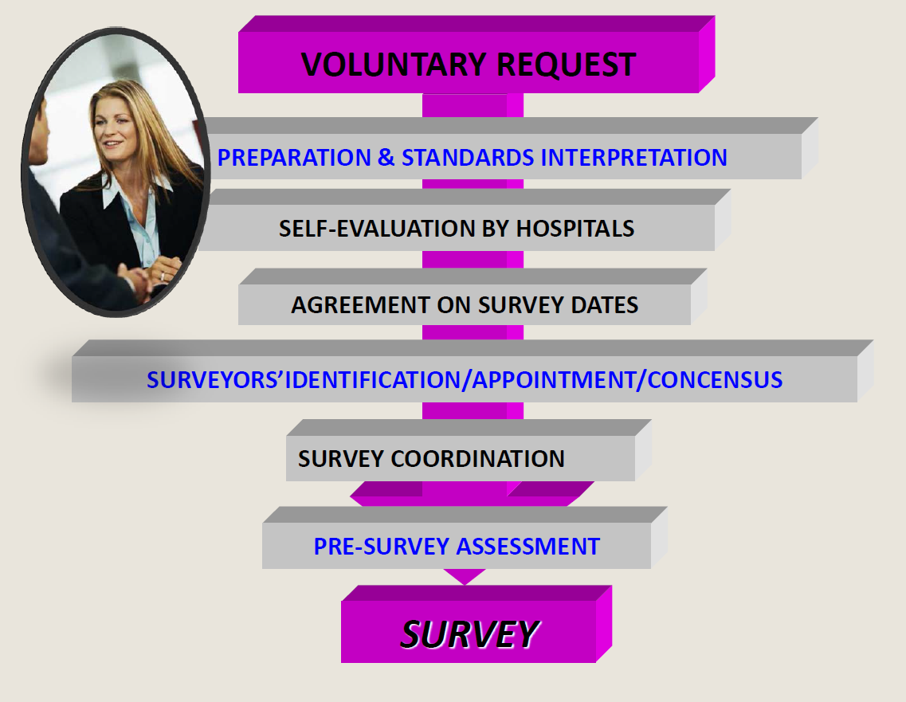
MSQH 4th EDITION STANDARDS ACCREDITATION PROCESS

Slide 13
PRE-SURVEY:
Objective:
For hospital to validate their hospital performance against the standards set by the MSQH

Slide 14
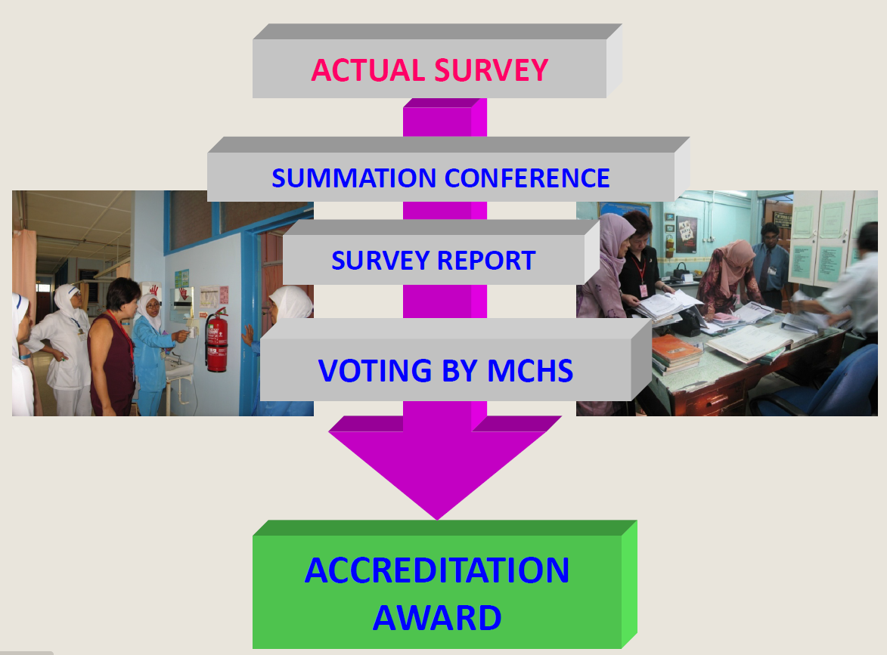

Slide 15
MSQH CERTIFICATION AWARD:
Full Compliance
4 Years Accreditation
Partial Compliance/Non Compliance
I Year Accreditation
FOCUS SURVEY
Non Accreditation
3 Years Accreditation

Slide 16

MSQH GANTT CHART & ACTION PLAN FOR 2nd CYCLE ACCREDITATION:
RE-ACCREDITATION ON 4th EDITION MSQH STANDARD 2015

Slide 17
DEPARTMENT STANDARD ANALYSIS
MSQH NOTES UPDATES (BY ASSOCIATE PROFFESSOR KADAR & MATRON ZAINA ON 8/10/2014
MSQH UPDATES | ACTION | REMARK
4th Edition Standards process: STANDARDS GAP ANALYSIS SC PC NC NA | Review all PC/NC reports and get feedback from HOD involved on current Departmental standards status. To complete all documentation by 3/3/2015 Starts logging into E-HAP: 9-16/3/2015 HOD to complete E-HAP on-line submission of respective Departmental Standards : 16/3/2015 PSQA Department review/revise all comments and rating and submit to MSQH on 17/4/2015. | MSQH response after E-HAP via on-line submission. MSQH open the access for about 2 weeks for rectification. Submitted revised comments/rating to MSQH 2 weeks before accreditation date
RCA
PDCA
RE-EVALUATE
IMPLEMENT

Slide 18

ACCREDITATION DATE:
1/6/2015
3/6/2015

Slide 19
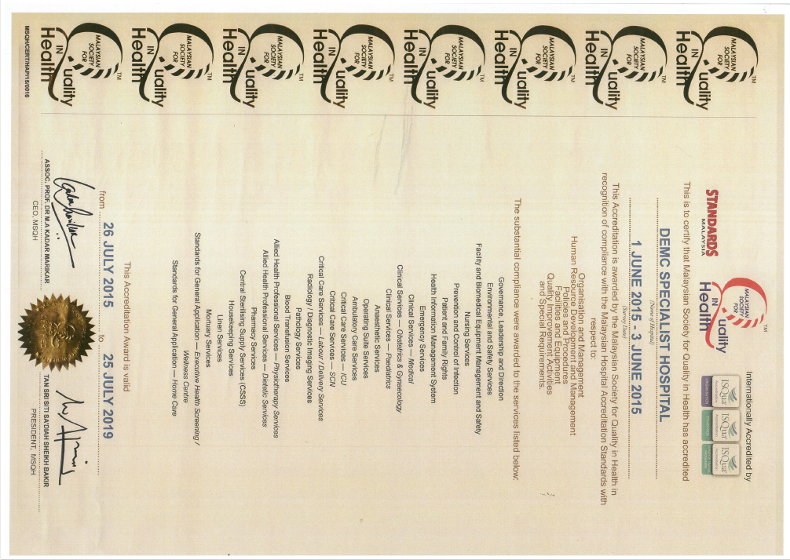

Slide 20


Slide 21


THANK YOU FOR YOUR ATTENTION!

